Slide 1
Numbers in the Bible
THE BASICS OF GOD IN MATHEMATICS

Slide 2
The first appearence of numbers
Where do numbers appear first in the Bible?

Slide 3
The first appearence of numbers
Where do numbers appear first in the Bible?
In the very beginning!

Slide 4
The first appearence of numbers
Where do numbers appear first in the Bible?
In the very beginning!
⁵ And God called the light Day, and the darkness he called Night. And the evening and the morning were the first day.
⁸ And God called the firmament Heaven. And the evening and the morning were the second day.
¹³ And the evening and the morning were the third day.

Slide 5
The first appearence of numbers
⁵ And God called the light Day, and the darkness he called Night. And the evening and the morning were the first day.
⁸ And God called the firmament Heaven. And the evening and the morning were the second day.
¹³ And the evening and the morning were the third day.
¹⁹ And the evening and the morning were the fourth day.
²³ And the evening and the morning were the fifth day.
³¹ And God saw every thing that he had made, and, behold, it was very good. And the evening and the morning were the sixth day.
2 Thus the heavens and the earth were finished, and all the host of them.
² And on the seventh day God ended his work which he had made; and he rested on the seventh day from all his work which he had made.
³ And God blessed the seventh day, and sanctified it: because that in it he had rested from all his work which God created and made.

Slide 6
Numbers in days
1. yom rishon = "first day" = (Sunday)
2. yom sheni = "second day" = (Monday)
3. yom sh'lishi = "third day" = (Tuesday)
4. yom revi'i = "fourth day" = (Wednesday)
5. yom chamishi = "fifth day" = (Thursday)
6. yom shishi = "sixth day" = (Friday)
7. yom shivee = "seventh day" is called shabbat = (Saturday)

Slide 7
Seven the number of completeness and perfection
God‘s creation is counted and marked with the number seven.

Slide 8
Seven the number of completeness and perfection
God‘s creation is counted and marked with the number seven.
7 great land masses form the complete earth

Slide 9
Seven the number of completeness and perfection
God‘s creation is counted and marked with the number seven.
7 great land masses form the complete earth
7 great bodies of water form a complete ocean

Slide 10
Seven the number of completeness and perfection
God‘s creation is counted and marked with the number seven.
7 great land masses form the complete earth
7 great bodies of water form a complete ocean
7 colors make a perfect spectrum and can be seen in the rainbow

Slide 11
Seven the number of completeness and perfection
God‘s creation is counted and marked with the number seven.
7 great land masses form the complete earth
7 great bodies of water form a complete ocean
7 colors make a perfect spectrum and can be seen in the rainbow
7 notes result in a perfect scale

Slide 12
Seven the number of completeness and perfection
God‘s creation is counted and marked with the number seven.
7 great land masses form the complete earth
7 great bodies of water form a complete ocean
7 colors make a perfect spectrum and can be seen in the rainbow
7 notes result in a perfect scale
In the beginning God created the heavens and the earth. (Gen 1 v 1) The first sentence in the Bible is made of 7 words in the original Hebrew language with 28 (4x7) letters.

Slide 13
Seven the number of completeness and perfection
God‘s creation is counted and marked with the number seven:
7 great land masses form the complete earth
7 great bodies of water form a complete ocean
7 colors make a perfect spectrum and can be seen in the rainbow
7 notes result in a perfect scale
In the beginning God created the heavens and the earth. (Gen 1 v 1) The first sentence in the Bible is made of 7 words in the original Hebrew language with 28 (4x7) letters.
The last book of the Bible is marked 55 times with the number 7.

Slide 14
Seven the number of Revelation
REVELATION mentions:
7 Churches , 7 Letters to the 7 Churches, 7 Golden Candlesticks, 7 Stars, 7 Angels, 7 Lamps of Fire, 7 Spirits of God, 7 Seal Judgments, 7 Horns and 7 Eyes on the Lamb, 7 Trumpets, 7 Trumpet Judgments, 7 Thunders, 7 Thousand Men Slain, 7 Heads and 7 Crowns on the Great Red Dragon, 7 Heads on the Leopard-like Beast of the Sea, 7 Last Plagues, 7 Golden Vials, 7 Bowl Judgments, 7 heads of blasphemy on the Scarlet Coloured Beast, 7 Mountains and 7 Kings.

Slide 15
Seven the number of Revelation
REVELATION mentions:
7 Churches , 7 Letters to the 7 Churches, 7 Golden Candlesticks, 7 Stars, 7 Angels, 7 Lamps of Fire, 7 Spirits of God, 7 Seal Judgments, 7 Horns and 7 Eyes on the Lamb, 7 Trumpets, 7 Trumpet Judgments, 7 Thunders, 7 Thousand Men Slain, 7 Heads and 7 Crowns on the Great Red Dragon, 7 Heads on the Leopard-like Beast of the Sea, 7 Last Plagues, 7 Golden Vials, 7 Bowl Judgments, 7 heads of blasphemy on the Scarlet Coloured Beast, 7 Mountains and 7 Kings.
The Lamb is mentioned 28 (4x7) times in Revelation.

Slide 16
Seven the number of the Holy Spirit
REVELATION 4, 5: And out of the throne proceeded lightnings and thunderings and voices: and there were seven lamps of fire burning before the throne, which are the seven Spirits of God.

Slide 17
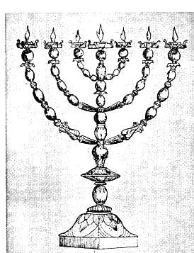
Seven the number of the lamps of the Menorah
Wisdom
Counsel
Knowledge
Understanding
Might
Fear
Isaiah 11:2 And the spirit of the LORD shall rest upon him, the spirit of wisdom and understanding, the spirit of counsel and might, the spirit of knowledge and of the fear of the LORD.

Slide 18
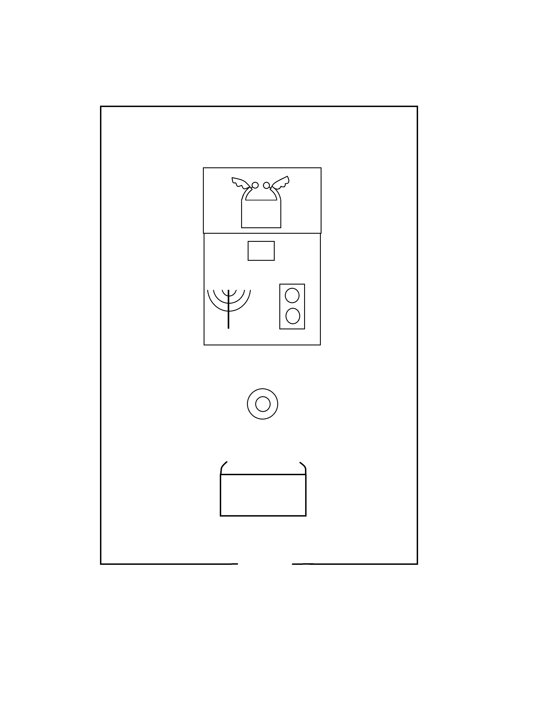
The Menorah first mentioned of Moses
The Menorah first mentioned in Exodus 25 in the description of the tabernacle with 7 special pieces of furniture:
-The Ark of the Covenant
-The Mercy Seat with the two Cherubim
-The Golden Altar of Incense
-The Table of Showbread
-The Menorah (Golden Lampstand)
-The Brazen Laver
-The Altar of Burnt Offering

Slide 19
The Sacrifice of 7 Lambs
Genesis 21:28-30 And Abraham set seven ewe lambs of the flock by themselves. And Abimelech said unto Abraham, What mean these seven ewe lambs which thou hast set by themselves? And he said, For these seven ewe lambs shalt thou take of my hand, that they may be a witness unto me, that I have digged this well
Leviticus 23:18 And ye shall offer with the bread seven lambs without blemish of the first year, and one young bullock, and two rams: they shall be for a burnt offering unto the Lord, with their meat offering, and their drink offerings, even an offering made by fire, of sweet savour unto the Lord.
Numbers 28:11 And in the beginnings of your months ye shall offer a burnt offering unto the Lord; two young bullocks, and one ram, seven lambs of the first year without spot;
Numbers 28:19 But ye shall offer a sacrifice made by fire for a burnt offering unto the Lord; two young bullocks, and one ram, and seven lambs of the first year: they shall be unto you without blemish:
Numbers 28:21 A several tenth deal shalt thou offer for every lamb, throughout the seven lambs:
Numbers 28:27 But ye shall offer the burnt offering for a sweet savour unto the Lord; two young bullocks, one ram, seven lambs of the first year;
Numbers 28:29 A several tenth deal unto one lamb, throughout the seven lambs;
Numbers 29:2 And ye shall offer a burnt offering for a sweet savour unto the Lord; one young bullock, one ram, and seven lambs of the first year without blemish:
Numbers 29:4 And one tenth deal for one lamb, throughout the seven lambs:
Numbers 29:8 But ye shall offer a burnt offering unto the Lord for a sweet savour; one young bullock, one ram, and seven lambs of the first year; they shall be unto you without blemish:
Numbers 29:10 A several tenth deal for one lamb, throughout the seven lambs:
Numbers 29:32 And on the seventh day seven bullocks, two rams, and fourteen lambs of the first year without blemish:
Numbers 29:36 But ye shall offer a burnt offering, a sacrifice made by fire, of a sweet savour unto the Lord: one bullock, one ram, seven lambs of the first year without blemish:
2 Chronicles 29:21 And they brought seven bullocks, and seven rams, and seven lambs, and seven he goats, for a sin offering for the kingdom, and for the sanctuary, and for Judah. And he commanded the priests the sons of Aaron to offer them on the altar of the Lord.

Slide 20
Noah taking 7 clean animals in the Ark
Genesis 7:2-4 Of every clean beast thou shalt take to thee by sevens, the male and his female: and of beasts that are not clean by two, the male and his female.
Of fowls also of the air by sevens, the male and the female; to keep seed alive upon the face of all the earth.
For yet seven days, and I will cause it to rain upon the earth forty days and forty nights; and every living substance that I have made will I destroy from off the face of the earth.
Genesis 7:10 And it came to pass after seven days, that the waters of the flood were upon the earth.
Genesis 7:11 In the six hundredth year of Noah's life, in the second month, the seventeenth day of the month, the same day were all the fountains of the great deep broken up, and the windows of heaven were opened.
Genesis 8:4 And the ark rested in the seventh month, on the seventeenth day of the month, upon the mountains of Ararat.
Genesis 8:10 And he stayed yet other seven days; and again he sent forth the dove out of the ark;
Genesis 8:12 And he stayed yet other seven days; and sent forth the dove; which returned not again unto him any more.

Slide 21
The Sabbatical year and Jubilee
Leviticus 25:1-4 and 8-9
And the Lord spoke unto Moses in mount Sinai, saying,
Speak unto the children of Israel, and say unto them, When ye come into the land which I give you, then shall the land keep a sabbath unto the Lord.
Six years thou shalt sow thy field, and six years thou shalt prune thy vineyard, and gather in the fruit thereof;
But in the seventh year shall be a sabbath of rest unto the land, a sabbath for the Lord: thou shalt neither sow thy field, nor prune thy vineyard.
And thou shalt number seven sabbaths of years unto thee, seven times seven years; and the space of the seven sabbaths of years shall be unto thee forty and nine years.
Then shalt thou cause the trumpet of the jubilee to sound on the tenth day of the seventh month, in the day of atonement shall ye make the trumpet sound throughout all your land.

Slide 22
7 year periods in the Old Testament
Genesis 29:18
And Jacob loved Rachel; and said, I will serve thee seven years for Rachel thy younger daughter.
Genesis 41: The dream of Pharao interpreted by Joseph
Seven fat cows and seven skinny cows
Seven ears of grain full-bodied and seven thin ears of grain stand for:
Seven years of plenty and seven years of famine.

Slide 23
7 year periods in the Old Testament
2 Samuel 24:13
So Gad came to David, and told him, and said unto him, Shall seven years of famine come unto thee in thy land? or wilt thou flee three months before thine enemies, while they pursue thee? or that there be three days' pestilence in thy land? now advise, and see what answer I shall return to him that sent me.
2 Kings 8:1
Then spake Elisha unto the woman, whose son he had restored to life, saying, Arise, and go thou and thine household, and sojourn wheresoever thou canst sojourn: for the Lord hath called for a famine; and it shall also come upon the land seven years.

Slide 24
7 times used in the Old Testament
Genesis 33:3 Jacob meets his brother Esau:
And he passed over before them, and bowed himself to the ground seven times, until he came near to his brother.
Leviticus 26:18 And if ye will not yet for all this hearken unto me, then I will punish you seven times more for your sins.
21 And if ye walk contrary unto me, and will not hearken unto me; I will bring seven times more plagues upon you according to your sins.
24 Then will I also walk contrary unto you, and will punish you yet seven times for your sins.
28 Then I will walk contrary unto you also in fury; and I, even I, will chastise you seven times for your sins.

Slide 25
7 times sprinkling of the priest
Leviticus 4:6 And the priest shall dip his finger in the blood, and sprinkle of the blood seven times before the Lord, before the vail of the sanctuary.
Leviticus 8:11 And he sprinkled thereof upon the altar seven times, and anointed the altar and all his vessels, both the laver and his foot, to sanctify them.
Leviticus 14:27 And the priest shall sprinkle with his right finger some of the oil that is in his left hand seven times before the LORD:
Leviticus 14:51 And he shall take the cedar wood, and the hyssop, and the scarlet, and the living bird, and dip them in the blood of the slain bird, and in the running water, and sprinkle the house seven times:
Leviticus 16:14 And he shall take of the blood of the bullock, and sprinkle it with his finger upon the mercy seat eastward; and before the mercy seat shall he sprinkle of the blood with his finger seven times.
Leviticus 16:19 And he shall sprinkle of the blood upon it with his finger seven times, and cleanse it, and hallow it from the uncleanness of the children of Israel.

Slide 26
7 times compassing of Jericho
Joshua 6:4,5
And seven priests shall bear before the ark seven trumpets of rams' horns: and the seventh day ye shall compass the city seven times, and the priests shall blow with the trumpets.
And it came to pass on the seventh day, that they rose early about the dawning of the day, and compassed the city after the same manner seven times: only on that day they compassed the city seven times.

Slide 27
7 times comanded of Elijah and Elisha
1 Kings 18:43 And said to his servant, Go up now, look toward the sea. And he went up, and looked, and said, There is nothing. And he said, Go again seven times.
2 Kings 4:35 Then he returned, and walked in the house to and fro; and went up, and stretched himself upon him: and the child sneezed seven times, and the child opened his eyes.
2 Kings 5:10 And Elisha sent a messenger unto him, saying, Go and wash in Jordan seven times, and thy flesh shall come again to thee, and thou shalt be clean.
2 Kings 5:14 Then went he down, and dipped himself seven times in Jordan, according to the saying of the man of God: and his flesh came again like unto the flesh of a little child, and he was clean.

Slide 28
7 times in Daniel
Daniel 3:19
Then was Nebuchadnezzar full of fury, and the form of his visage was changed against Shadrach, Meshach, and Abednego: therefore he spake, and commanded that they should heat the furnace one seven times more than it was wont to be heated.
Daniel 4:16
Let his heart be changed from man's, and let a beast's heart be given unto him; and let seven times pass over him.
Daniel 4:32
And they shall drive thee from men, and thy dwelling shall be with the beasts of the field: they shall make thee to eat grass as oxen, and seven times shall pass over thee, until thou know that the most High ruleth in the kingdom of men, and giveth it to whomsoever he will.

Slide 29
7 times in Psalms and Proverbs
Psalm 12:6
The words of the Lord are pure words: as silver tried in a furnace of earth, purified seven times.
Psalm 119:164
Seven times a day do I praise thee because of thy righteous judgments.
Proverbs 24:16
For a just man falleth seven times, and riseth up again: but the wicked shall fall into mischief.

Slide 30
The number 7 in the Gospels
Mark 8, 5-9
And he asked them, How many loaves have ye? And they said, Seven.
And he commanded the people to sit down on the ground: and he took the seven loaves, and gave thanks, and brake, and gave to his disciples to set before them; and they did set them before the people.
And they had a few small fishes: and he blessed, and commanded to set them also before them.
So they did eat, and were filled: and they took up of the broken meat that was left seven baskets.
And they that had eaten were about four thousand: and he sent them away.

Slide 31
The number 7 in the Gospels
Matthew 22, 25-30
Now there were with us seven brethren: and the first, when he had married a wife, deceased, and, having no issue, left his wife unto his brother:
Likewise the second also, and the third, unto the seventh.
And last of all the woman died also.
Therefore in the resurrection whose wife shall she be of the seven? for they all had her.
Jesus answered and said unto them, Ye do err, not knowing the scriptures, nor the power of God.
For in the resurrection they neither marry, nor are given in marriage, but are as the angels of God in heaven.

Slide 32
The number 7 in the Gospels
Matthew 18, 21-22
Then came Peter to him, and said, Lord, how oft shall my brother sin against me, and I forgive him? till seven times?
Jesus saith unto him, I say not unto thee, Until seven times: but, Until seventy times seven.
Genesis 4, 15 + 24
And the Lord said unto him, Therefore whosoever slayeth Cain, vengeance shall be taken on him sevenfold. And the Lord set a mark upon Cain, lest any finding him should kill him.
If Cain shall be avenged sevenfold, truly Lamech seventy and sevenfold.

Slide 33
The number 7 in the Gospels
Matthew 12:45
Then goeth he, and taketh with himself seven other spirits more wicked than himself, and they enter in and dwell there: and the last state of that man is worse than the first. Even so shall it be also unto this wicked.
Mark 16:9
Now when Jesus was risen early the first day of the week, he appeared first to Mary Magdalene, out of whom he had cast seven devils.

Slide 34
The number 7 in the Gospels
Matthew 12:45
Then goeth he, and taketh with himself seven other spirits more wicked than himself, and they enter in and dwell there: and the last state of that man is worse than the first. Even so shall it be also unto this wicked.
Mark 16:9
Now when Jesus was risen early the first day of the week, he appeared first to Mary Magdalene, out of whom he had cast seven devils.
The first day of the week is Sunday, the day after Sabbath, the 7th day.

Slide 35
The number 8 as New Beginning
8th day starts the week over again.

Slide 36
The number 8 as New Beginning
8th day starts the week over again.
8th note on a piano starts the scale over again.

Slide 37
The number 8 as New Beginning
8th day starts the week over again.
8th note on a piano starts the scale over again.
8 people were on the ark for a new beginning after the flood.
Ge 7:13 In the selfsame day entered Noah, and Shem, and Ham, and Japheth, the sons of Noah, and Noah's wife, and the three wives of his sons with them, into the ark;
1Pe 3:20 Which sometime were disobedient, when once the longsuffering of God waited in the days of Noah, while the ark was a preparing, wherein few, that is, eight souls were saved by water.
2Pe 2:5 And spared not the old world, but saved Noah, one of eight persons, a preacher of righteousness, bringing in the flood upon the world of the ungodly;

Slide 38
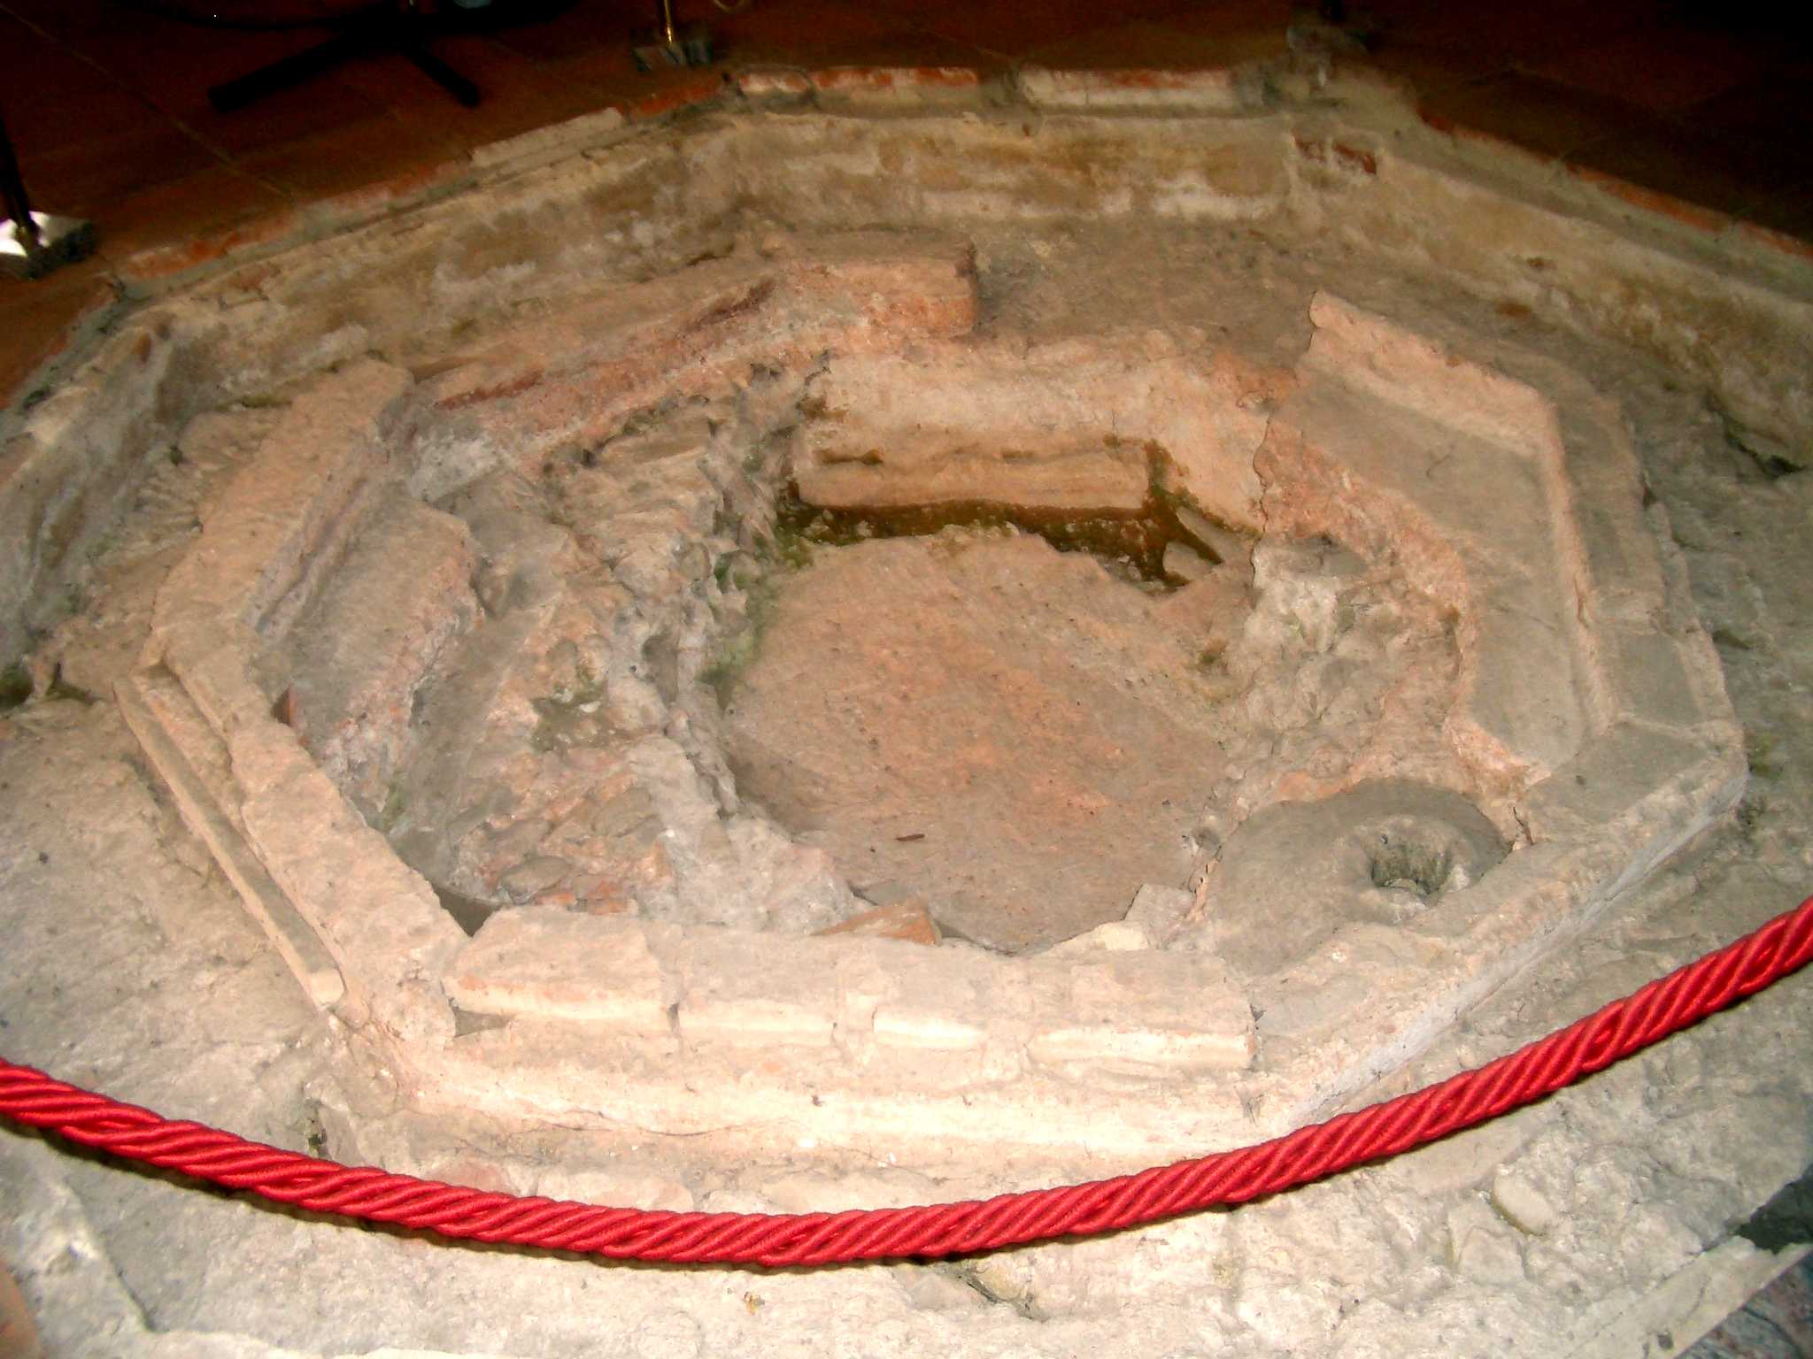
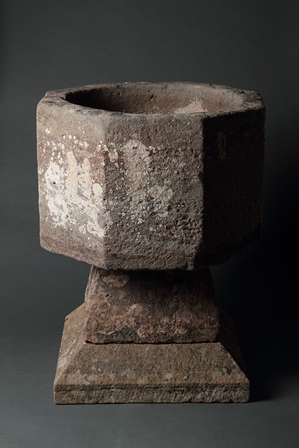
The number 8 as New Beginning
8 as symbol of baptismal fonts because of Noah and his family.

Slide 39
The number 8 - Symbol of Ressurection
On the 8th day (day after the Sabbath, the 7th day) Jesus rose from the dead:
John 20:1 Now on the first day of the week Mary Magdalene went to the tomb early, while it was still dark, and saw that the stone had been taken away from the tomb.

Slide 40
The number 8 - Symbol of Ressurection
On the 8th day (day after the Sabbath, the 7th day) Jesus rose from the dead:
John 20:1 Now on the first day of the week Mary Magdalene went to the tomb early, while it was still dark, and saw that the stone had been taken away from the tomb.
John 20:26 And after eight days again his disciples were within, and Thomas with them: then came Jesus, the doors being shut, and stood in the midst, and said, Peace be unto you.

Slide 41
The number 8 - Symbol of Ressurection
On the 8th day (day after the Sabbath, the 7th day) Jesus rose from the dead:
John 20:1 Now on the first day of the week Mary Magdalene went to the tomb early, while it was still dark, and saw that the stone had been taken away from the tomb.
John 20:26 And after eight days again his disciples were within, and Thomas with them: then came Jesus, the doors being shut, and stood in the midst, and said, Peace be unto you.
Excluding Jesus eight people were resurrected in the Bible (1 Kings 17:17-22, 17:17-22, 2 Kings 4:30-37, 13:21, John 11:38-44, Luke 7:11-17, Matthew 8:28-43, Acts 20:7-12, Acts 20:7-12, Acts 9:36-42)

Slide 42

The number 8 - Symbol of Eternity
The scientific symbol for Infintiy is an 8 on its side:
The resurrection of Christ made Eternity possible for you and me.

Slide 43
The number 8 as new beginning
8 beatitudes of the sermon on the mountain. (Matthew 5:3-11)
8th day a male child was circumcised according to the law.
8th day the first-born was given to Jahwe (Exodus 22:29,30)

Slide 44
The number 888 numeric value of Jesus
JESUS ( IESOUS in Greek - Ιησούς ) = 888 The New Testament of the Bible was originally written in Greek. In the Greek alphabet each of its letters has a numeric value. The numeric values of these Greek letters add up to Ιησούς = 10 + 8 + 200 + 70 + 400 + 200 = 888

Slide 45
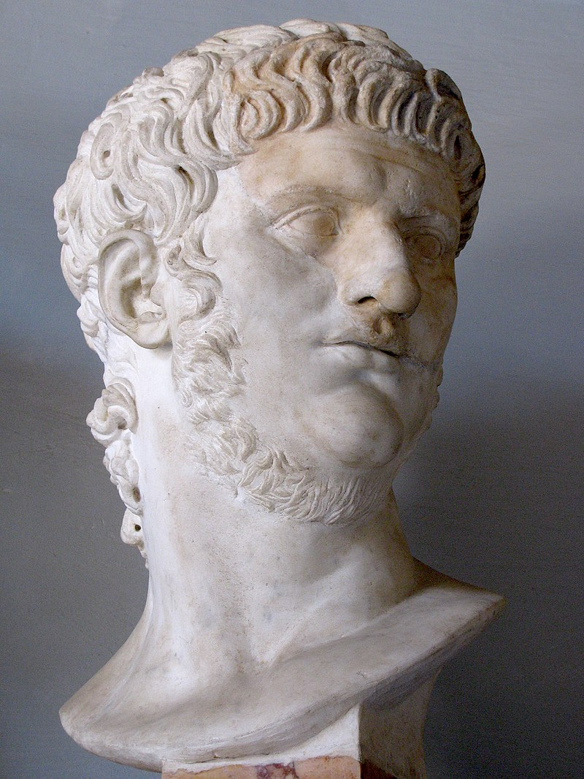
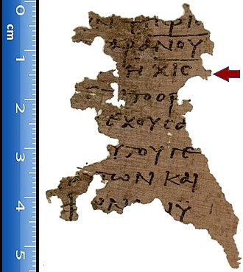
The number 666 numerical value of the beast
Neron Caesar translated from Greek
NRON QSR spelled in Hebrew נרון קסר 50 + 200 + 6 + 50 + 100 + 60 + 200 = 666
Nero Caesar translated from Latin
NRO QSR spelled in Hebrewנרו קסר 50 + 200 + 6 + 100 + 60 + 200 = 616 χιϛʹ
Papyrus 115 a writing of Revelation 13 verse 18 around year 300
Nero persecuting the Christians after the great fire AD 64 in Rome and killing Peter and Paul.

Slide 46
The number 6 and 6 and 6 with Solomon
1 Kings 10:14
Now the weight of gold that came to Solomon in one year was six hundred sixty and six talents of gold,
2 Chronicles 9:13
Now the weight of gold that came to Solomon in one year was six hundred and sixty and six talents of gold;
1 Kings 10:19
The throne had six steps, and the top of the throne was round behind: and there were stays on either side on the place of the seat, and two lions stood beside the stays.

Slide 47
The number 6 when God created man
Genesis 1:27, 31
²⁷ So God created man in his own image, in the image of God created he him; male and female created he them.
³¹ And God saw every thing that he had made, and, behold, it was very good. And the evening and the morning were the sixth day.
Exodus 20:9,11
⁹ Six days shalt thou labour, and do all thy work.
¹¹ For in six days the Lord made heaven and earth, the sea, and all that in them is, and rested the seventh day: wherefore the Lord blessed the sabbath day, and hallowed it.

Slide 48
The number of labour 6
Exodus 16:26
²⁶ Six days ye shall gather it; but on the seventh day, which is the sabbath, in it there shall be none.
Exodus 21:2
² If thou buy an Hebrew servant, six years he shall serve: and in the seventh he shall go out free for nothing.

Slide 49
The number 6 in Daniel
Daniel 3:1,5
¹Nebuchadnezzar the king made an image of gold, whose height was sixty cubits, and the breadth thereof six cubits: he set it up in the plain of Dura, in the province of Babylon.
⁵ That at what time ye hear the sound of the cornet, flute, harp, sackbut, psaltery, dulcimer, and all kinds of music, ye fall down and worship the golden image that Nebuchadnezzar the king hath set up:

Slide 50
The number 6 with giants
1 Samuel 17:4
And there went out a champion out of the camp of the Philistines, named Goliath, of Gath, whose height was six cubits and a span.
1 Samuel 17:7
And the staff of his spear was like a weaver's beam; and his spear's head weighed six hundred shekels of iron: and one bearing a shield went before him.
2 Samuel 21:20
And there was yet a battle in Gath, where was a man of great stature, that had on every hand six fingers, and on every foot six toes, four and twenty in number; and he also was born to the giant.

Slide 51
The number 6 in John
John2:6
And there were set there six waterpots of stone, after the manner of the purifying of the Jews, containing two or three firkins apiece.

Slide 52
The number 6 in Luke
Luke 23:44-45
And it was about the sixth hour, and there was a darkness over all the earth until the ninth hour.
And the sun was darkened, and the veil of the temple was rent in the midst.

Slide 53
The number 5
You have five fingers, five toes, five senses.

Slide 54
The number 5 in scripture
We know the 5 books of law (Genesis – Deuteronomy)
The word Pentateuch comes from two Greek words that mean "five books" or "five scrolls“

Slide 55
The number 5 in scripture
We know the 5 books of law (Genesis – Deuteronomy)
The word Pentateuch comes from two Greek words that mean "five books" or "five scrolls“
Psalms is also divided in 5 books
Jesus gives 5 major speeches in the gospel of Matthew

Slide 56
The number 5 in scripture
In the Levitical law we see five kinds of animals sacrificed: goats, sheep, cattle, pigeons and doves.
The number five is also very significant in the tabernacle

Slide 57
The number 5 in the tabernacle
In Exodus God gave a detailed description of the tabernacle with
five curtains (Exodus 26:3),
five bars (Exodus 26:26 - 27),
five pillars and five sockets (Exodus 26:37)
the altar made of wood was five cubits long and five cubits wide (Exodus 27:1).
The height of the court within the tabernacle was five cubits (Exodus 27:18).
The Holy anointing oil (Exodus 30:23 - 25) was made of five parts. The proportion of spices used in making the oil were a multiple of five:
Pure Myrrh, 500 shekels Pure Myrrh and 250 shekels Sweet cinnamon,
250 shekels Sweet calamus and 500 shekels Cassia

Slide 58
The number 5 in scripture
Five loaves of bread in Mt 14,17-21
Five brothers in Luke 16 who would not believe Moses and the prophets
Five husbands could not satisfy the woman at the well in John 4

Slide 59
The number 5 in scripture
Do ye not yet understand, neither remember the five loaves of the five thousand, and how many baskets ye took up?
For I have five brethren; that he may testify unto them, lest they also come into this place of torment.
The fact is, you have had five husbands, and the man you now have is not your husband. What you have just said is quite true.

Slide 60
The number 5 in scripture
Matthew 25, 2
And five of them were wise, and five were, and five were foolish.
Matthew 25, 16
Then he that had received the five talents went and traded with the same, and made them other five talents.
John 5, 2
Now there is at Jerusalem by the sheep market a pool, which is called in the Hebrew tongue Bethesda, having five porches.

Slide 61
The number of grace: 5
^{1. Samuel 17, 40}
And he took his staff in his hand, and chose him five smooth stones out of the brook, and put them in a shepherd's bag which he had, even in a scrip; and his sling was in his hand: and he drew near to the Philistine.

Slide 62
The number 4
Four Corners of the earth in Revelation 7,1
Four Cardinal directions (North, South, East, West)
Four Seasons (summer, autumn, winter, and spring)
Four Elements (earth, fire, water, air)
Four Divisions of the day (morning, noon, evening, and midnight).
Four Phases of the moon
Four Winds (Matthew 24, 31)
Four Rivers of Paradise
Four Horns at the altar

Slide 63
The Gospel preached on all earth
Four Gospels
Acts 1:8
But ye shall receive power, after that the Holy Ghost is come upon you: and ye shall be witnesses unto me both in Jerusalem, and in all Judaea, and in Samaria, and unto the uttermost part of the earth.
Four types of hearts of people receiving the gospel
Matthew 13: Parable of the farmer sowing seed on four types of ground
Some fell on the path, onto rocky places, among thorns and on
good soil

Slide 64
The number 4
Mark 8, 18-21
Having eyes, see ye not? and having ears, hear ye not? and do ye not remember?
When I brake the five loaves among five thousand, how many baskets full of fragments took ye up? They say unto him, Twelve.
And when the seven among four thousand, how many baskets full of fragments took ye up? And they said, Seven.
And he said unto them, How is it that ye do not understand?

Slide 65
The number 4
Four generals took over Alexander’s kingdom
Four horns (gentile powers) of Zechariah
Four guardians of the throne of God
Four horsemen will bring calamity on the earth in Revelation 6
Four acts of judgment — sword, famine, evil beasts, pestilence in Ezekiel 14
Revelation 20, 8
And shall go out to deceive the nations which are in the four quarters of the earth, Gog, and Magog, to gather them together to battle: the number of whom is as the sand of the sea.

Slide 66
The number 3
Father, Son and Holy Spirit revealed in one scripture
Matthew 3, 16-17
And Jesus, when he was baptized, went up straightway out of the water: and, lo, the heavens were opened unto him, and he saw the Spirit of God descending like a dove, and lighting upon him:
And lo a voice from heaven, saying, This is my beloved Son, in whom I am well pleased.

Slide 67
The number 3
Father, Son and Holy Spirit revealed in the Ark of the Covenant:
Ten commandments, Rod that budded, Golden Pot of Manna
Two Cherubims, Mercy Seat, gold-covered wooden chest

Slide 68
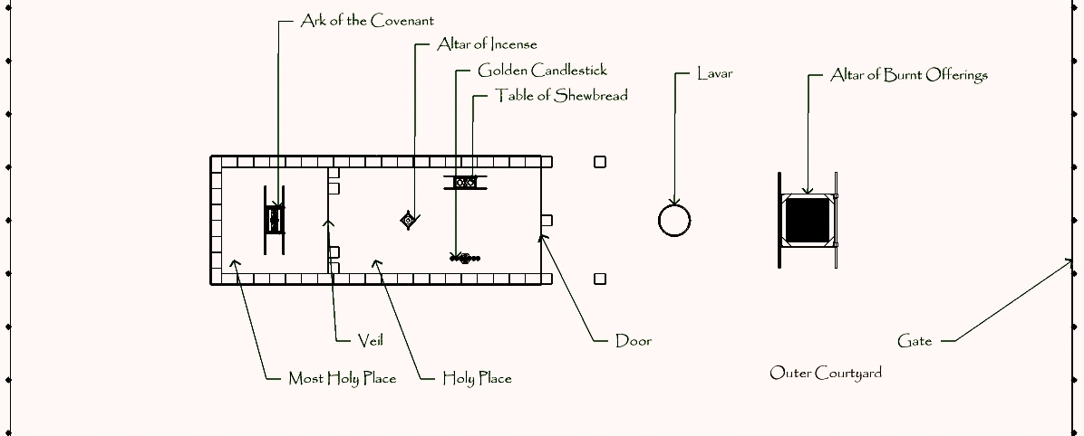
The number 3
The number three in the division of tabernacle and temple
Outer Court, Holy Place, Most Holy Place

Slide 69
The number 3
The number three in the Ark of the Covenant
Ten commandments, Rod that budded, Golden Pot of Manna
Two Cherubims, Mercy Seat, gold-covered wooden chest
The number three in the Noah’s ark:
3 stories high and 300 hundred cubits long in size

Slide 70
The number 3
Threefold division of men:
1. Thessalonians 5, 23
And the very God of peace sanctify you wholly; and I pray God your whole spirit and soul and body be preserved blameless unto the coming of our Lord Jesus Christ.
The number three in the office of Christ:
Prophet, Priest and King.

Slide 71
The three days prediction of Jesus
Matthew 12, 40
For as Jonas was three days and three nights in the whale's belly; so shall the Son of man be three days and three nights in the heart of the earth.
Matthew 27, 63
Saying, Sir, we remember that that deceiver said, while he was yet alive, After three days I will rise again.
Mark 8, 31
And he began to teach them, that the Son of man must suffer many things, and be rejected of the elders, and of the chief priests, and scribes, and be killed, and after three days rise again.

Slide 72
The number 3
The number three in time:
Present, Past, Future
Revelation 1:4
John to the seven churches which are in Asia: Grace be unto you, and peace, from him which is, and which was, and which is to come; and from the seven Spirits which are before his
Revelation 1:8
I am Alpha and Omega, the beginning and the ending, saith the Lord, which is, and which was, and which is to come, the Almighty.
Revelation 4:8
And the four beasts had each of them six wings about him; and they were full of eyes within: and they rest not day and night, saying, Holy, holy, holy, Lord God Almighty, which was, and is, and is to come.

Slide 73
The number 3
The Sheperd Psalm Trilogy about
Past, Present, Future
Psalm 22: his death
Psalm 23: his presence
Psalm 24: his future glory
Hebrews 13:20 Now the God of peace, that brought again from the dead our Lord Jesus, that great shepherd of the sheep, through the blood of the everlasting covenant,
John 10:14 I am the good shepherd, and know my sheep, and am known of mine.
1 Peter 5:4 And when the chief Shepherd shall appear, ye shall receive a crown of glory that fadeth not away.

Slide 74
The number 3
The number three in measurement:
Length, Width, and Height
26 times length in Ezekiel and 21 times in Exodus
Ephesians 3, 17-19
That Christ may dwell in your hearts by faith; that ye, being rooted and grounded in love,
May be able to comprehend with all saints what is the breadth, and length, and depth, and height;
And to know the love of Christ, which passeth knowledge, that ye might be filled with all the fulness of God.

Slide 75
The threefold temptation
The three temptations of Eve: The tree was good for food, pleasant to the eyes and desired to make one wise.
The three temptations in the words of Satan:
“If You are the Son of God, command that these stones become bread.”
“If You are the Son of God, throw Yourself down. For it is written: ‘ He shall give His angels charge over you,’ and,‘ In their hands they shall bear you up, Lest you dash your foot against a stone.’”
“All these things I will give You if You will fall down and worship me.”
The three temptations of man: the lust of the flesh, lust of the eyes, pride of life

Slide 76
The number 2
Two as a symbol of witness, testimony, decision, division.

Slide 77
The number 2
Two as a symbol of witness, testimony, decision, division.
John 8, 17 It is also written in your law, that the testimony of two men is true.
Deuteronomy 17, 6 At the mouth of two witnesses, or three witnesses, shall he that is worthy of death be put to death; but at the mouth of one witness he shall not be put to death.
Revelation 11, 2-4 But the court which is without the temple leave out, and measure it not; for it is given unto the Gentiles: and the holy city shall they tread under foot forty and two months.
And I will give power unto my two witnesses, and they shall prophesy a thousand two hundred and threescore days, clothed in sackcloth.
These are the two olive trees, and the two candlesticks standing before the God of the earth.

Slide 78
The number 2
Two as a symbol of witness, testimony, division, decision.
Exodus 8, 23 And I will put a division between my people and thy people: to morrow shall this sign be.
Exodus 31, 18 And he gave unto Moses, when he had made an end of communing with him upon mount Sinai, two tables of testimony, tables of stone, written with the finger of God.

Slide 79
The 10 commandments on 2 tablets
Deuteronomy 4:13
And he declared unto you his covenant, which he commanded you to perform, even ten commandments; and he wrote them upon two tables of stone.
We have two hands with ten fingers.
Luke 16, 13 No servant can serve two masters: for either he will hate the one, and love the other; or else he will hold to the one, and despise the other. Ye cannot serve God and mammon.

Slide 80
Two Cherubim and two Angels
You can know about two cherubim at the ark of the covenant:
Exodus 25, 18 And thou shalt make two cherubims of gold, of beaten work shalt thou make them, in the two ends of the mercy seat.
We read about two angels at the garden grave:
John 20, 12 And seeth two angels in white sitting, the one at the head, and the other at the feet, where the body of Jesus had lain.

Slide 81
Two olive trees as anointed ones
Zechariah 4, 11-14 Then answered I, and said unto him, What are these two olive trees upon the right side of the candlestick and upon the left side thereof?
And I answered again, and said unto him, What be these two olive branches which through the two golden pipes empty the golden oil out of themselves?
And he answered me and said, Knowest thou not what these be? And I said, No, my lord.
Then said he, These are the two anointed ones, that stand by the Lord of the whole earth.

Slide 82
The number 1
God, the source of all
1 Corinthians 8,6 But to us there is but one God, the Father, of whom are all things, and we in him; and one Lord Jesus Christ, by whom are all things, and we by him.

Slide 83
The number 1
Deuteronomy 6:4
Hear, O Israel: The Lord our God is one Lord:
Genesis 1:9
And God said, Let the waters under the heaven be gathered together unto one place, and let the dry land appear: and it was so.
Genesis 2:24
Therefore shall a man leave his father and his mother, and shall cleave unto his wife: and they shall be one flesh.

Slide 84
The number 1
Ephesians 4, 4-6
There is one body, and one Spirit, even as ye are called in one hope of your calling;
One Lord, one faith, one baptism,
One God and Father of all, who is above all, and through all, and in you all.

Slide 85
The number 1
1 Timothy 2, 5 For there is one God, and one mediator between God and men, the man Christ Jesus;
Galatians 3, 20 Now a mediator is not a mediator of one, but God is one.
Hebrews 10, 12-14 But this man, after he had offered one sacrifice for sins for ever, sat down on the right hand of God;
From henceforth expecting till his enemies be made his footstool.
For by one offering he hath perfected for ever them that are sanctified.

Slide 86
The number 1
Matthew 23, 8-11
But be not ye called Rabbi: for one is your Master, even Christ; and all ye are brethren.
And call no man your father upon the earth: for one is your Father, which is in heaven.
Neither be ye called masters: for one is your Master, even Christ.
But he that is greatest among you shall be your servant.

Slide 87
The number 1 in John 10
John 10, 16
And other sheep I have, which are not of this fold: them also I must bring, and they shall hear my voice; and there shall be one fold, and one shepherd.
John 10, 30
I and my Father are one.

Slide 88
The number 1 in John 17
John 17:11
And now I am no more in the world, but these are in the world, and I come to thee. Holy Father, keep through thine own name those whom thou hast given me, that they may be one, as we are.
John 17:21
That they all may be one; as thou, Father, art in me, and I in thee, that they also may be one in us: that the world may believe that thou hast sent me.
John 17:22
And the glory which thou gavest me I have given them; that they may be one, even as we are one:
John 17:23
I in them, and thou in me, that they may be made perfect in one; and that the world may know that thou hast sent me, and hast loved them, as thou hast loved me.

Slide 89
The Holy One in Psalms
Psalm 16:10
For thou wilt not leave my soul in hell; neither wilt thou suffer thine Holy One to see corruption.
Psalm 71:22
I will also praise thee with the psaltery, even thy truth, O my God: unto thee will I sing with the harp, O thou Holy One of Israel.
Psalm 78:41
Yea, they turned back and tempted God, and limited the Holy One of Israel.
Psalm 89:18
For the Lord is our defence; and the Holy One of Israel is our king.

Slide 90
The number 9
Nine as a symbol of fruitfulness

Slide 91
The number 9
Nine as a symbol of fruitfulness
Nine month period a baby stays in the mothers womb till the fruit is visible for all.

Slide 92
The number 9
Nine as a symbol of fruitfulness
Galatians 5, 22-23
But the fruit of the Spirit is love, joy, peace, longsuffering, gentleness, goodness, faith,
Meekness, temperance: against such there is no law.

Slide 93
The number 9
Nine as a symbol of fruitfulness
1 Corinthians 12, 8-10
For to one is given by the Spirit the word of wisdom; to another the word of knowledge by the same Spirit;
To another faith by the same Spirit; to another the gifts of healing by the same Spirit;
To another the working of miracles; to another prophecy; to another discerning of spirits; to another divers kinds of tongues; to another the interpretation of tongues:

Slide 94
The number 9
Nine times Jesus says blessed in Matthew 5, 3-11
³ Blessed are the poor in spirit: for theirs is the kingdom of heaven.
⁴ Blessed are they that mourn: for they shall be comforted.
⁵ Blessed are the meek: for they shall inherit the earth.
⁶ Blessed are they which do hunger and thirst after righteousness: for they shall be filled.
⁷ Blessed are the merciful: for they shall obtain mercy.
⁸ Blessed are the pure in heart: for they shall see God.
⁹ Blessed are the peacemakers: for they shall be called the children of God.
¹⁰ Blessed are they which are persecuted for righteousness' sake: for theirs is the kingdom of heaven.
¹¹ Blessed are ye, when men shall revile you, and persecute you, and shall say all manner of evil against you falsely, for my sake.

Slide 95
The number 9
Nine as a symbol of judgement

Slide 96
The number 9
Nine as a symbol of judgement
2 Kings 17, 6
In the ninth year of Hoshea the king of Assyria took Samaria, and carried Israel away into Assyria, and placed them in Halah and in Habor by the river of Gozan, and in the cities of the Medes.

Slide 97
The number 9
Nine as a symbol of judgement
2 Kings 25, 1
And it came to pass in the ninth year of his reign, in the tenth month, in the tenth day of the month, that Nebuchadnezzar king of Babylon came, he, and all his host, against Jerusalem, and pitched against it; and they built forts against it round about

Slide 98
The number 9
The hour Jesus died on the cross
Matthew 47, 46
And about the ninth hour Jesus cried with a loud voice, saying, Eli, Eli, lama sabachthani? that is to say, My God, my God, why hast thou forsaken me?

Slide 99
The number 9
The hour of prayer and the Greek Amen
Acts 3,1 Now Peter and John went up together into the temple at the hour of prayer, being the ninth hour.
Acts 10, 3 + 30 He saw in a vision evidently about the ninth hour of the day an angel of God coming in to him, and saying unto him, Cornelius.
³⁰ And Cornelius said, Four days ago I was fasting until this hour; and at the ninth hour I prayed in my house, and, behold, a man stood before me in bright clothing,
There are 99 Amens in the gospels.
In Gematria the numerical value of ἀμήν in Greek is 1 + 40 + 8 + 50 = 99

Slide 100
The number 10
Ten as a Symbol of Law, order, testing and trial

Slide 101
The number 10
Ten as a Symbol of Law, order, testing and trial
Exodus 34
²⁷ And the Lord said unto Moses, Write thou these words: for after the tenor of these words I have made a covenant with thee and with Israel.
²⁸ And he was there with the Lord forty days and forty nights; he did neither eat bread, nor drink water. And he wrote upon the tables the words of the covenant, the ten commandments.

Slide 102
The number 10
Ten as a Symbol of Law, order, testing and trial
Daniel 1
¹² Prove thy servants, I beseech thee, ten days; and let them give us pulse to eat, and water to drink.
¹³ Then let our countenances be looked upon before thee, and the countenance of the children that eat of the portion of the king's meat: and as thou seest, deal with thy servants.
¹⁴ So he consented to them in this matter, and proved them ten days.
¹⁵ And at the end of ten days their countenances appeared fairer and fatter in flesh than all the children which did eat the portion of the king's meat.

Slide 103
The number 10
Ten as a Symbol of Law, order, testing and trial
Daniel 7, 24
And the ten horns out of this kingdom are ten kings that shall arise: and another shall rise after them; and he shall be diverse from the first, and he shall subdue three kings.
Revelation 17, 12
And the ten horns which thou sawest are ten kings, which have received no kingdom as yet; but receive power as kings one hour with the beast.

Slide 104
The number 10
Ten as a Symbol of Law, order, testing and trial
Revelation 13, 1
And I stood upon the sand of the sea, and saw a beast rise up out of the sea, having seven heads and ten horns, and upon his horns ten crowns, and upon his heads the name of blasphemy.
Revelation 17, 7
And the angel said unto me, Wherefore didst thou marvel? I will tell thee the mystery of the woman, and of the beast that carrieth her, which hath the seven heads and ten horns.

Slide 105
The number 10
Ten in tithing
Genesis 14, 20
And blessed be the most high God, which hath delivered thine enemies into thy hand. And he gave him tithes of all.
Hebrews 7, 2-4
To whom also Abraham gave a tenth part of all; first being by interpretation King of righteousness, and after that also King of Salem, which is, King of peace;
Without father, without mother, without descent, having neither beginning of days, nor end of life; but made like unto the Son of God; abideth a priest continually.
Now consider how great this man was, unto whom even the patriarch Abraham gave the tenth of the spoils.

Slide 106
The number 10
Ten in the Tabernacle of Moses and Temple of Salomon
Exodus 26, 1
Moreover thou shalt make the tabernacle with ten curtains of fine twined linen, and blue, and purple, and scarlet: with cherubims of cunning work shalt thou make them.
2 Chronicles 4, 6-8
He made also ten lavers, and put five on the right hand, and five on the left, to wash in them: such things as they offered for the burnt offering they washed in them; but the sea was for the priests to wash in.
And he made ten candlesticks of gold according to their form, and set them in the temple, five on the right hand, and five on the left.
He made also ten tables, and placed them in the temple, five on the right side, and five on the left. And he made an hundred basons of gold.

Slide 107
The number 10
Ten in the Gospels
Matthew 25, 1
Then shall the kingdom of heaven be likened unto ten virgins, which took their lamps, and went forth to meet the bridegroom.
Luke 17, 17
And Jesus answering said, Were there not ten cleansed? but where are the nine?
Luke 19, 16-17
Then came the first, saying, Lord, thy pound hath gained ten pounds.
And he said unto him, Well, thou good servant: because thou hast been faithful in a very little, have thou authority over ten cities.

Slide 108
The number 10
Ten in the Psalms
Psalm 33, 2
Praise the Lord with harp: sing unto him with the psaltery and an instrument of ten strings.
Psalm 92, 3
Upon an instrument of ten strings, and upon the psaltery; upon the harp with a solemn sound.
Psalm 144, 9
I will sing a new song unto thee, O God: upon a psaltery and an instrument of ten strings will I sing praises unto thee.

Slide 109
Numbers in the Bible
The end of God’s basics/multiplication table with the last verse of the Psalms, which is a commandment for all of us:
Psalm 150, 6
Let every thing that hath breath praise the LORD! Praise ye the LORD!

